Slide 1


Banking App
With JDBC

Slide 2

CONTENT
01
JAVA
02
JDBC Connections
03
SCOPE OF PROJECT
04
PROJECT CONFIGURATIONS
05
DEPENDENCIES
06
FUNCTIONAL REQUIREMENTS
07
OPERATING ENVIRONMENT USED
08
HIERARCHY OF PROJECT ARTIFACTS

Slide 3


Java
Java is a high-level, class-based, object-oriented programming language. It is a compiled language, which means that the Java source code is converted into byte code that can be executed by the Java Virtual Machine (JVM).
Java is a popular programming language for a variety of applications, including web development, mobile development, and enterprise software development.
Some of the Key features of JAVA are:
Object Oriented
Platform Independent
Secure
Robust
.

Slide 4
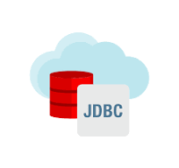
JDBC
JDBC allows JAVA programs to connect to databases
Provides Connectivity and data access across relational databases from different vendors
Classes and Interfaces allow users to access the database in a standard way.
JDBC makes it possible to do:
Establish a connection with a database
Send SQL statements
Process the results

Slide 5

SCOPE OF PROJECT
The Bank App aims to provide a comprehensive solution for handling and
processing financial transactions within a banking environment.
The Scope of the Project includes the key components :
Transaction Processing
Facilitate the processing of Deposit(D) and Withdrawal(W) transactions.
Validate transactions against predefined rules.
Transaction Classification
Classify transactions either “VALID” or “InValid”.
Database Integration
Interact with an MySQL database to store and retrieve transactions data.
Maintain separate table for Valid and Invalid transactions for auditing purposes.
User Interface
Display a summary of Valid and Invalid Transactions for easy monitoring.

Slide 6
Project CONFIGs
Database Connection Configuration
Connection String i.e. JDBC URL
Project Specific Configurations

Slide 7
DEPENDENCIES
MySQL-connector :
MySQL Connector is a software component that enables communication between applications and the MySQL database server.
MySQL Connector provides drivers or libraries that facilitate the connection and communication processes.
MySQL Driver:
It acts as a bridge or interface that allows programming languages and applications to interact with a MySQL database.
Specify the JDBC URL in the DriverManager.getconnection(); along the MYSQL DB details Such as username and password.

Slide 8


COMPONENTS
BASE CLASS : Test
ConnectionProvider Class :
DAO Classes :
primary class responsible for managing bank transactions and run entire functionality.
FetchTransactions
InsertTransactions
UpdateTransactions
DisplayAllTransactions
class responsible for managing database connections.
use of the singleton pattern to ensure a single connection instance.

Slide 9
Utility Methods
Method :
calculateNewBalance
method responsible for
calculating the new balance
based on transaction type.
updateTransactions
method responsible for
updating transaction details
in the database.
Method :
insertIntoTransaction
method responsible for
Inserting transactions into appropriate tables.
DisplayAllTransactions
method responsible for
displaying all transactions in all tables
Method :
getConnection
method responsible for
obtaining database connection.
closeConnection
method responsible for
closing the database connection
LOGIN PAGE 1
LOGIN PAGE 2

Slide 10
Method CHAINING
Programming technique known as "method chaining" entails invoking
several methods on an object within a single, continuous line of code.
Every method in a method chain is called based on the outcome of the
one before it, and the process keeps going until the intended tasks are finished.
It enhances code readability and conciseness, making complex operations
more straightforward.

Slide 11
REQUIREMENT ID | REQUIREMENT CATEGORY | REQUIREMENT TYPE | PRIORITY | HIERARCHY | REF
R001 | FUNCTIONAL | STATED | HIGH
REQUIREMENT DESCRIPTION | ESTABLISHING DATABASE CONNECTION
SCOPE | This functionality involves establishing a connection to the MySQL database to facilitate interactions with transaction records.
REQUIREMENT METHODOLOGICAL DETAILS | Implementation Details: Uses JDBC to load the MySQL driver and establish a connection. Ensures the connection is created only if it does not already exist. Considerations: Handles exceptions related to database connection, printing stack traces if necessary.

Slide 12
REQUIREMENT ID | REQUIREMENT CATEGORY | REQUIREMENT TYPE | PRIORITY | HIERARCHY | REF
R001 | FUNCTIONAL | STATED | HIGH
REQUIREMENT DESCRIPTION | UPDATING TRANSACTION RECORDS
SCOPE | This functionality involves updating transaction details, such as new balance and transaction status, in the database.
REQUIREMENT METHODOLOGICAL DETAILS | Parameters: newBal: New balance after the transaction. validity: Transaction validity status (Valid/Invalid). transID: Unique identifier for the transaction. Implementation Details: Prepares and executes an SQL update statement using JDBC. Updates the NewBal and TransStat columns in the transactions table.

Slide 13
REQUIREMENT ID | REQUIREMENT CATEGORY | REQUIREMENT TYPE | PRIORITY | HIERARCHY | REF
R001 | FUNCTIONAL | STATED | HIGH
REQUIREMENT DESCRIPTION | INSERTING TRANSACTION RECORDS
SCOPE | This functionality involves inserting transaction records into the appropriate tables based on their validity.
REQUIREMENT METHODOLOGICAL DETAILS | Parameters: tableName: Name of the table (ValidTrans/InValidTrans). transID, transType, transAmt: Transaction details. validity: Transaction validity status (Valid/Invalid). Implementation Details: Determines the appropriate SQL query based on the table name. Prepares and executes the insertion statement using JDBC.

Slide 14
REQUIREMENT ID | REQUIREMENT CATEGORY | REQUIREMENT TYPE | PRIORITY | HIERARCHY | REF
R001 | FUNCTIONAL | STATED | HIGH
REQUIREMENT DESCRIPTION | DISPLAY ALL TRANSACTION RECORDS
SCOPE | This functionality involves displaying all transaction records from the transactions, ValidTrans, and InValidTrans tables.
REQUIREMENT METHODOLOGICAL DETAILS | Implementation Details : Executes SQL queries to fetch records from the respective tables. Prints the retrieved records to the console in a formatted manner. Considerations : Handles SQL exceptions and prints stack traces in case of errors.

Slide 15

OPERATING ENVIRONMENT
Database and Server:
MySQL Server: Ensure proper configuration.
Version: Compatible with MySQL,
specify the version.
Java Environment:
JRE Version: Specify the required Java Runtime Environment version.
Dependencies: List necessary libraries or dependencies.
Development Environment:
Integrated Development Environment (IDE): Mention the IDE used for development (e.g., IntelliJ IDEA, Eclipse).
Network and Configuration:
Connection: Stable network connection to the MySQL database server.
Ports: Specify required open network ports.
Security: Briefly mention security measures and configuration files.

Slide 16
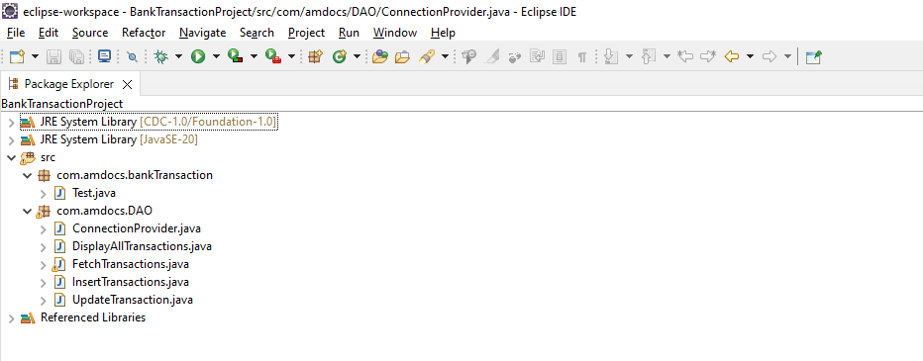
Hierarchy of Project Artifacts

Slide 17

THANKYOU
By :
Gauri Sonawane

